Slide 1

E-Insurance Management System
.
Project guide:
Prof. Satish k. Maurya
Company guide:
Dhaval Prajapati
Prepared by:
Darshan Vasoya (20012021070)

Slide 2
Introduction
This edition delves into pertinent topics spanning business, regulatory, and accounting realms, reflecting the ongoing debates within the insurance industry. From forecasting the future of micro insurance to navigating challenges posed by platforms like Combine portal and their impact on consolidation principles, insurers face an exhilarating yet demanding era. With evolving customer behaviors and technological advancements, particularly in online and social media spheres, customer expectations have shifted dramatically. The rise of customer-centric internet businesses has raised the performance standards across all retail sectors, compelling insurers to reevaluate their approaches. Customers now seek simplicity, transparency, and trust in their insurance providers, desiring products tailored to their needs. To meet these demands, a user-friendly methodology has been developed, aimed at attracting both informed and novice individuals to embrace insurance solutions.

Slide 3
Problem Statement
The current insurance system presents challenges due to lengthy procedures and reliance on intermediaries. Purchasing life insurance involves options like banks, agents, or online platforms, each with its own drawbacks. Banks often lack clarity on procedures and post-purchase services, leaving customers to handle tasks themselves. Dealing with agents raises concerns about certification and integrity, with many providing inadequate knowledge or resorting to mis-selling tactics. Online insurance, while convenient for the educated, faces low adoption due to security concerns and lack of centralized platforms. This decentralization makes it difficult for customers to manage multiple policies efficiently and compare products effectively. A lack of centralized solutions and comprehensive explanations further compounds the issue, leaving customers feeling unreliable and underserved by the industry.

Slide 4
Objective
The development of an e-insurance management system focuses on several key objectives to enhance efficiency, improve customer service, facilitate data-driven decision-making, and maintain a competitive edge in the digital era. Firstly, streamlining insurance processes through digitization and centralization aims to reduce administrative burdens and errors while expediting policy issuance and claims settlement. Secondly, by prioritizing customer satisfaction and retention, the system offers self-service portals and intuitive interfaces for policyholders, enabling seamless access to insurance information and easy online transactions. Thirdly, leveraging data analytics empowers insurers to make informed decisions, tailor offerings, and identify market trends, thereby enhancing strategic planning and risk management. Lastly, embracing technological advancements and offering innovative digital solutions positions insurers to stand out in the market, attract new customers, and retain existing ones, aligning with the broader trend of digital transformation in the industry.

Slide 5
Tools and technology used
Front end: HTML, CSS, JavaScript
HTML: HTML is used to create and save web document.
CSS : (Cascading Style Sheets) Create attractive Layout
JavaScript: it is a programming language, commonly use with web browsers.

Slide 6
Tools and technology used
Back end: PHP, MySQL
PHP(version - 8.2): Hypertext Preprocessor (PHP) is a technology that allows software developers to create dynamically generated web pages, in HTML, XML, or other document types, as per client request. PHP is open source software.
MySQL: MySQL is a database, widely used for accessing querying, updating, and managing data in databases.

Slide 7
Modules
There are 3 Modules:
Administrator
User
Staff

Slide 8
Modules (USER)
Insurance: In this section, the user can apply for a policy and check whether his policy is approved or rejected.
Ticket: In this section, the user can raise tickets against any to complain and see the status of his/her ticket User can also update his/ her profile, change the password, and recover the password.

Slide 9
Modules (STAFF)
Dashboard: In this section, staff can see all the details based on him/her in brief.
Policy Holders: In this section, staff can view insurance policy status.
Tickets: In this section, staff can view details of tickets assigned to him/her.

Slide 10
Modules (ADMIN)
Dashboard: In this section, the admin can see all the details in brief.
Insurance Category: In this section, the admin can manage categories (add and update).
Insurance Subcategory: In this section, the admin can manage the subcategory (add and update).
Insurance Policy: In this section, the admin can manage the insurance policy (add and update policy).
User Detail: In this section, the admin can manage all user details.
Policy Holders: In this section, the admin can manage all insured policies. Admin can view the policy on the basis of status (pending policy, approved policy, and disapproved policy). Admin also can approve the pending policy.
Tickets: In this section, the admin can view details of issues raised by the user and can also update remarks on particular tickets or assign them to staff.

Slide 11
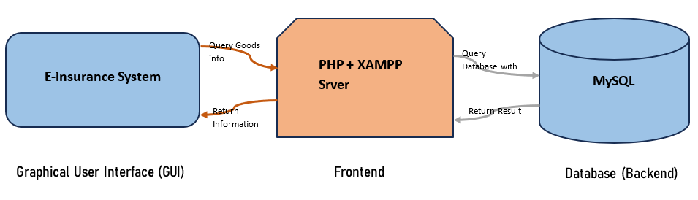
SYSTEM ARCHITECTURE

Slide 12
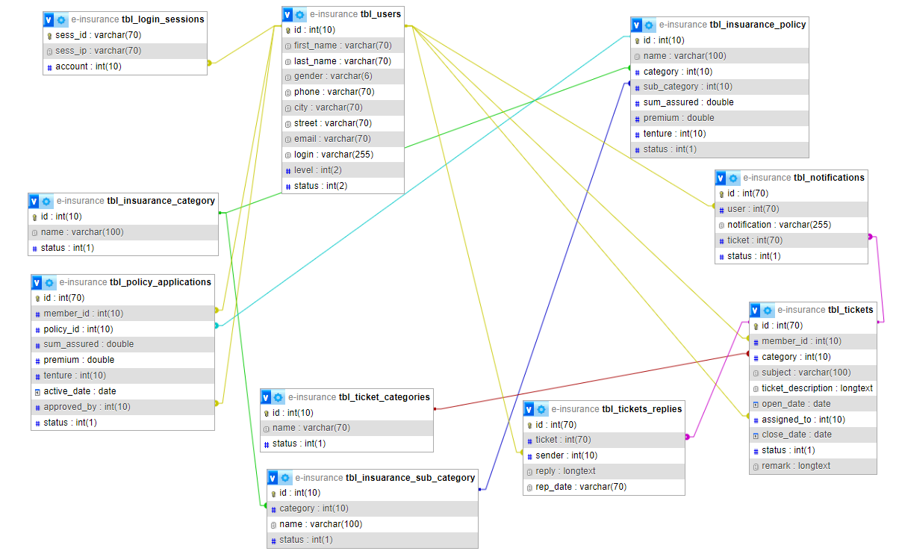
Class Diagram

Slide 13
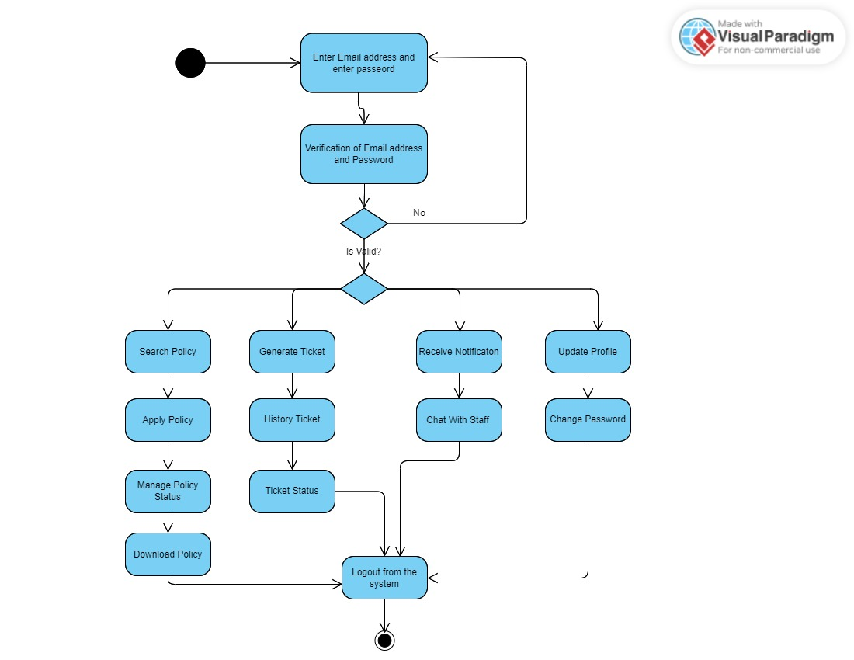
Activity Diagram (USER)

Slide 14
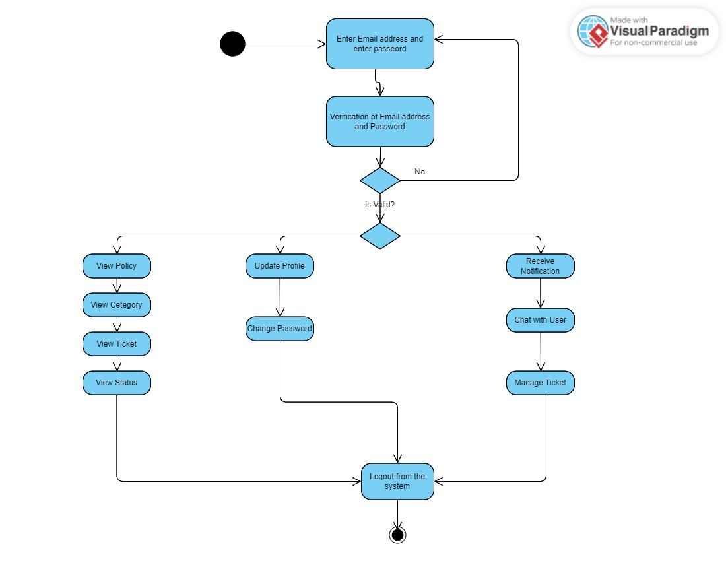
Activity Diagram (STAFF)

Slide 15
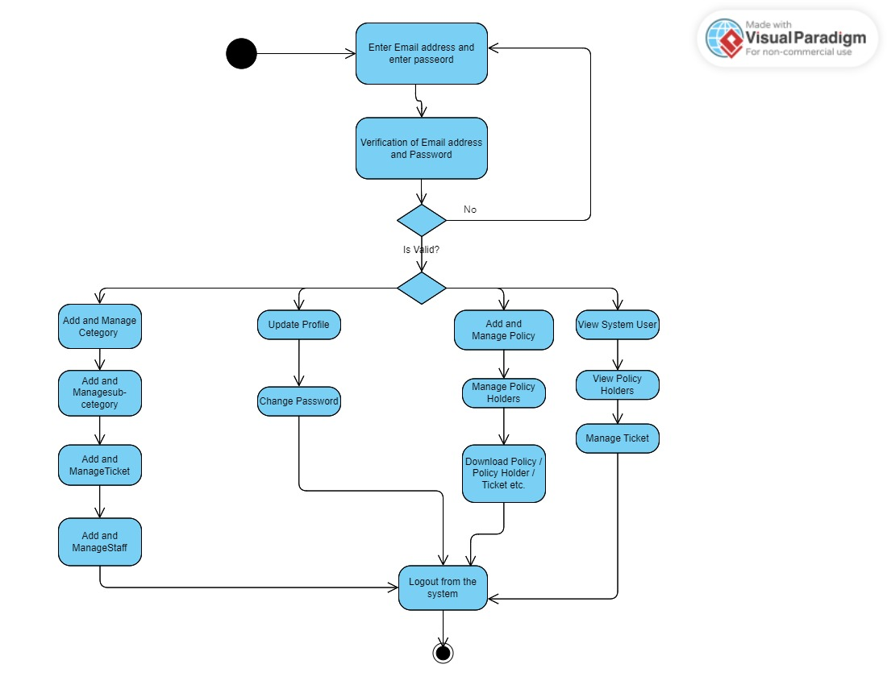
Activity Diagram (ADMIN)

Slide 16
Conclusion
In conclusion, the proposed insurance management system (IMS) presents a promising solution to address the limitations of the current system and enhance insurance operations. With its modular and scalable architecture, intuitive user interface, and advanced security measures, the new system offers improved functionality, usability, and data protection. However, it is essential to acknowledge the potential challenges and limitations associated with implementing and maintaining the system, including complexity during implementation, technical glitches, scalability concerns, and ongoing maintenance requirements. Despite these challenges, the benefits of the new system, such as enhanced efficiency, better user experience, and compliance with regulatory standards, outweigh the drawbacks. With careful planning, diligent testing, and proactive management, the IMS has the potential to revolutionize insurance management, driving operational excellence and delivering value to insurers and their stakeholders.

Slide 17


